Slide 1
Real-Time and Image-Based Emotion Recognition
Detecting Emotions from Faces via Real-Time Video and Image Input

Slide 2
Introduction
Emotion plays a crucial role in human communication and interaction.
Understanding facial emotions can help machines respond more
empathetically to users, making human-computer interaction more natural
and intelligent.
This project aims to build a web-based application that can detect human
emotions using
facial expressions in two ways:
Real-Time Detection through a webcam.
Image-Based Detection through uploaded photos.
By leveraging machine learning and computer vision, this app can identify
emotions such as:
Angry, Happy, Sad
Surprise, Neutral

Slide 3
Problem statement
Despite significant advancements in artificial intelligence, many systems still lack the ability to understand and respond to human emotions effectively.
There is a growing need for applications that can interpret facial expressions to:
Improve human-computer interaction
Enhance user experience in real-time applications
Enable emotion-aware systems in areas like education, mental health, and customer service

Slide 4
Scope and motivation
SCOPE
Develop a web-based application that detects facial emotions.
Use deep learning (CNN) and OpenCV for face detection and emotion classification.
Classify emotions into 6 categories: Angry, Happy, Neutral, Sad, Surprise , fear.
Deploy the system with a clean, responsive UI using Flask.
MOTIVATION:
Emotions are vital in expressing human intentions and reactions.
Creating emotion-aware systems improves communication between humans and machines.
Useful in domains like:
E-learning (detect student engagement)
Mental health (track emotional state)
Customer service (real-time emotion tracking)
Gaming and entertainment

Slide 5
Objective
To design and implement a facial emotion detection system using deep learning.
To capture real-time video through an integrated webcam and detect emotions.
To allow users to upload images and detect emotions from static photos.
To classify facial expressions into 6 basic emotions: Angry, Fear, Happy, Neutral, Sad, Surprise.
To provide a user-friendly web interface using Flask and HTML/CSS.
To ensure fast and accurate predictions using a pre-trained CNN model

Slide 6
Literature review
Mollahosseini et al. (2017) – AffectNet
Built a large-scale facial expression dataset.
Used deep neural networks to classify facial emotions in the wild.
Achieved high accuracy by combining multiple features.
Goodfellow et al. (2013) – Challenges in FER
Discussed challenges like lighting, pose variation, and occlusion in real-world emotion detection.
Proposed using convolutional neural networks (CNNs) for improved performance.
Tang (2013) – CNN on FER2013 Dataset
Used a deep CNN model on the FER2013 dataset (which you are using too).
Improved emotion classification accuracy significantly.
Szegedy et al. (2015) – Inception Architecture
Inspired efficient CNN design to reduce training time and increase detection speed.
These ideas influenced modern FER models.

Slide 7
Dataset
🔹 Dataset Used:
FER-2013 (Facial Expression Recognition 2013)
Contains 35,887 grayscale images of size 48x48.
Each image is labeled with one of 7 emotions:
Angry, Disgust, Fear, Happy, Sad, Surprise, Neutral
Collected from Google image search APIs.
Used widely in facial emotion detection research.

Slide 8
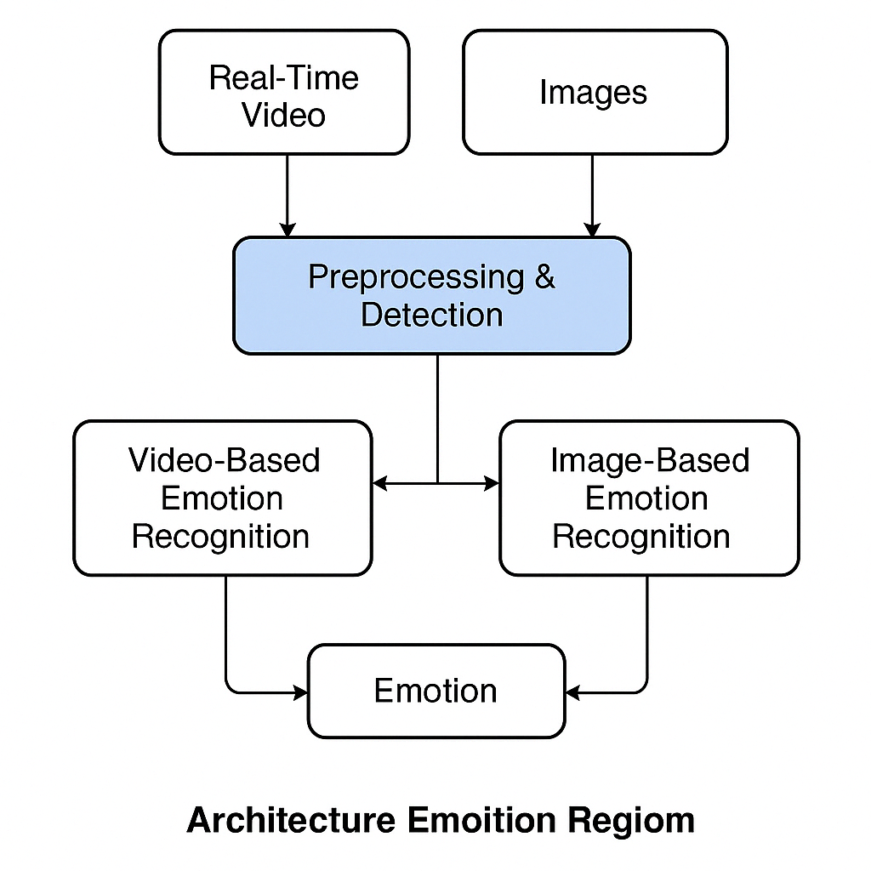
System architecture

Slide 9

Modules
1. Data Preprocessing Module
Handles resizing, grayscale conversion, and normalization of input images.
Prepares webcam frames and uploaded images for prediction.
2. Model Loading & Prediction Module
Loads the trained CNN model .
Predicts the emotion class from processed face images.
3. Webcam Detection Module
Accesses the device’s built-in webcam using OpenCV.
Detects faces in real-time and predicts emotions on live video feed.
4. Image Upload Detection Module
Accepts image input via HTML form.
Processes the uploaded image and returns the detected emotion.
5. Flask Web Interface Module
Renders the index.html page.
Connects front-end actions (like webcam or image upload) to back-end functions.
6. Frontend UI Module
Uses HTML, CSS (red and blue theme), and JavaScript for styling and responsiveness.
Displays live camera feed and prediction result clearly to the user.

Slide 10

Tools
Programming language – python
Deep learning – tensorflow
Web framework – flask
Model format- .h5
Frontend-HTML,CSS,jS

Slide 11
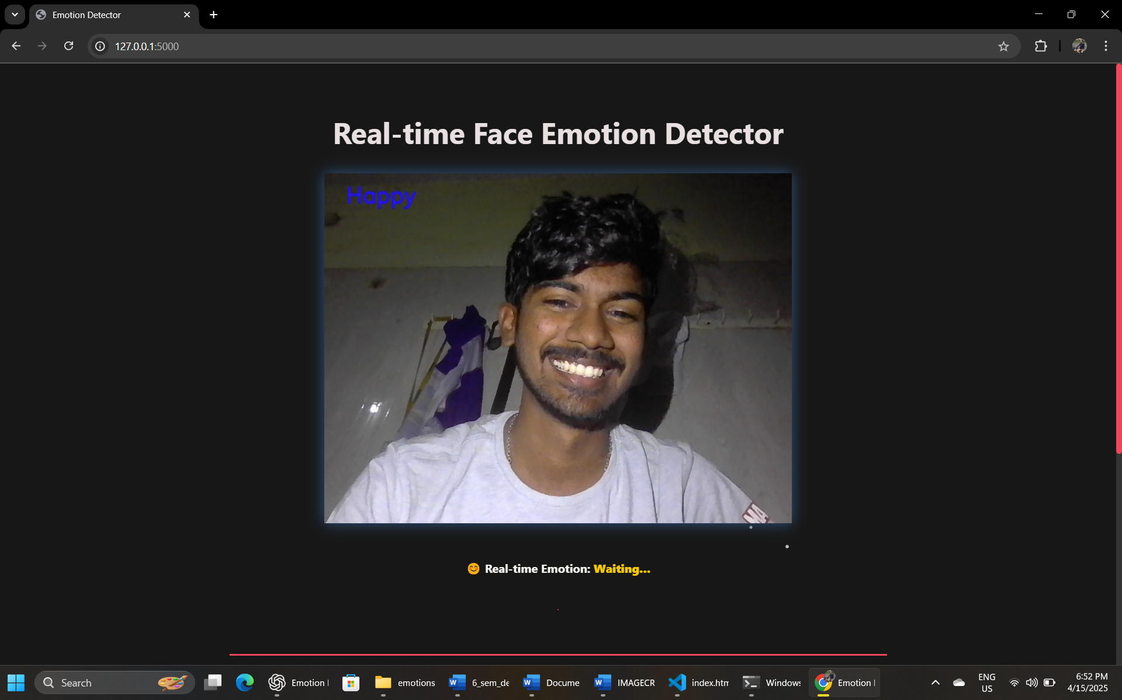
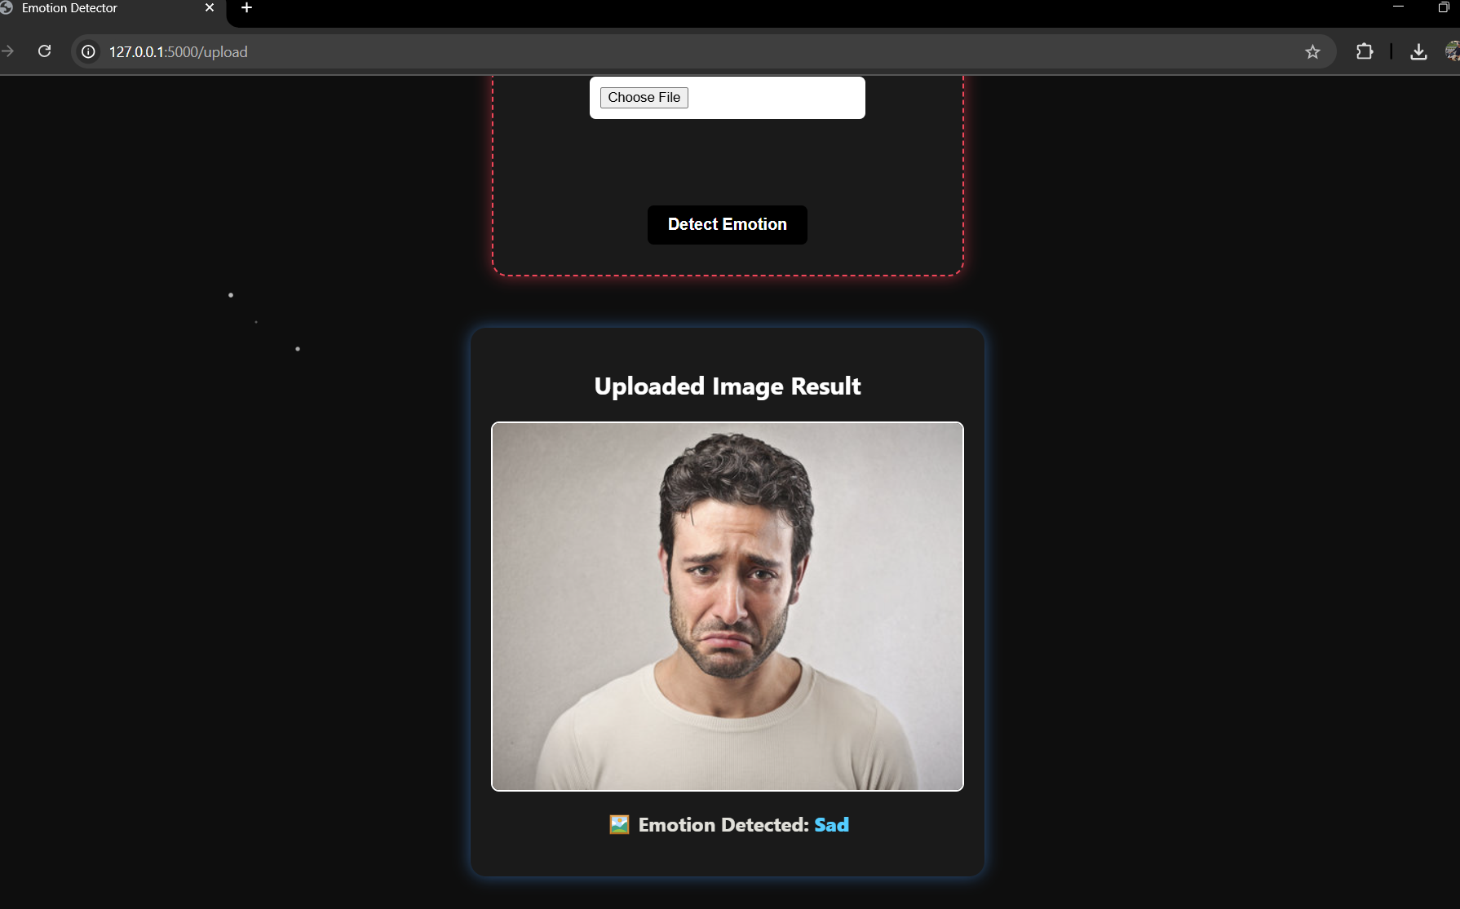
Experimental result

Slide 12
Evaluation
Testing Methods
Real-Time Webcam Input Live camera feed tested for emotion detection under different lighting and facial orientations.
Static Image Upload Images of various emotions were uploaded and processed to verify model accuracy and flexibility.
Performance Metrics
Accuracy: ~70–75% on the FER-2013 dataset.
Response Time: Emotion predicted in ~0.5 seconds per frame.
Model Size: ~15MB (optimized for web deployment).
Lag: Minimal when using system with moderate specifications.
Observed Challenges
Slight lag due to model complexity.
Some misclassifications under poor lighting or occluded faces.
Neutral emotions often over-predicted — a known challenge in facial emotion models.

Slide 13
Conclusion
The Real-Time Facial Emotion Detection Web App successfully detects and displays human emotions using webcam and image input.
It integrates deep learning (CNN) with Flask and OpenCV to provide a responsive and interactive user experience.
The system can recognize 7 basic emotions: Angry, Disgust, Fear, Happy, Neutral, Sad, and Surprise.
Additional features like image upload and clean UI design enhance usability.
This project demonstrates how AI can be applied to human behavior analysis in areas such as mental health monitoring, education, and human-computer interaction.

Slide 14

Future work
Improve
Improve Accuracy: Train the model with larger and more diverse datasets like AffectNet or RAF-DB.
Deploy
Mobile Integration: Deploy the emotion detection system into a mobile app for on-the-go analysis.
Enhance
Multi-face Emotion Detection: Enhance to detect and classify emotions of multiple people in the same frame.
Include
Contextual Emotion Understanding: Include voice tone, body language, and text sentiment for more accurate predictions.
Store
Cloud Integration: Store data securely and run real-time analysis on cloud servers for better performance and scalability.

Slide 15
References
FER-2013 Dataset – Facial Expression Recognition dataset used for training.
OpenCV Documentation – https://docs.opencv.org
Keras & TensorFlow Docs – https://keras.io, https://www.tensorflow.org
Mollahosseini et al., “AffectNet: A Database for Facial Expression, Valence, and Arousal Computing in the Wild.”
Research papers and articles on facial emotion recognition and CNN model architectures.

